Slide 1



CSN6224 COMPUTER NETWORK
GROUP NAME: THE 202 Network GROUP NO.: 11
By : EBA MOHAMED ABBAS AHMED (242UC243BE)
LAMA M. R. SIAM (242UC243B4)
SITI ZULAIKHA BINTI ABDUL RAZIF (242UC243TL)
Moo Yu Jie (1191100199)

Slide 2
IP ADDRESSING SCHEME
Based on birth date
IP format:
- IPv4:
202.day.month.0/24
- IPv6: 2001:db8:DDMM:YYYY::/64
Eba - IPv4: 202.10.12.0/24
- IPv6: 2001:db8:1012:2006::/64
Lama - IPv4: 202.3.10.0/24
Zulaikha - IPv6: 2001:db8:0909:2005
Moo - IPv4: 202.2.6.0/24
- IPv6: 2001:db8:0206:2001::/64

Slide 3
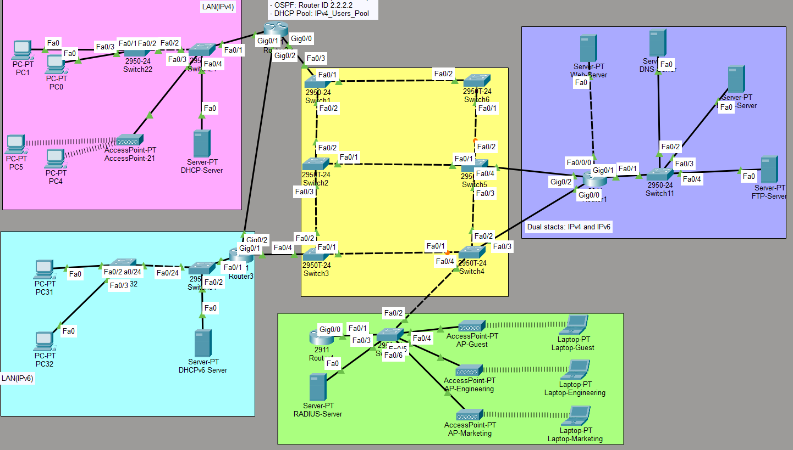
PROJECT OVERVIEW

Slide 4
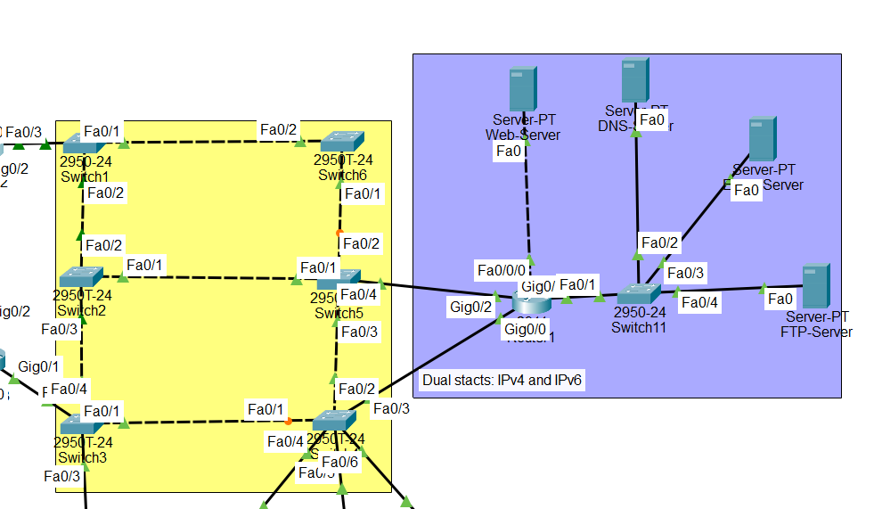
Core Network & Dual Stack Server Network
EBA MOHAMED ABBAS AHMED
242UC243BE

Slide 5

NETWORKS CONFIGURED BY MEMBER 1
🟨 Network 3 Core Network | 🟣 Network 4 Dual-Stack Servers | Network 6 🟪 Web Server
6 Switches | DNS Server | 202.10.13.2
STP Enabled | Email Server | Direct to R1
Redundant Mesh | FTP Server | Crossover Cable
Trunk Links | Dual Stack | Via Fa0/0/0
 | 202.10.12.0/24 | VLAN 1 config
Footer: IPv4: 202.10.12.x & 202.10.13.x | IPv6: 2001:db8:1012:2006:: & 2001:db8:1013:2006::

Slide 6
YELLOW AREA (CORE) + PURPLE AREA (SERVERS)
HIGH AVAILABILITY CORE
Devices:
6 x Cisco 2950-24 Switches
CoreSwitch1 (Root Bridge)
CoreSwitch2, 3, 4, 5, 6
Features:
1- Spanning Tree Protocol (RSTP)
• Priority 4096 (Root)
• 12 FWD, 4 BLK ports
2- 802.1q Trunk Links
• All inter-switch connections
• Native VLAN 1
3- Redundant Topology
• Multiple paths
• Automatic failover

Slide 7
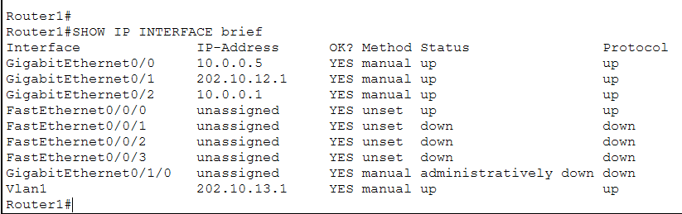
WEB SERVER - CHALLENGE AND SOLUTION
The Challenge:
REQUIREMENT: Web Server → Router1 Fa0/0/0 (Crossover Cable)
PROBLEM: Fa0/0/0 = Switch port (cannot route)
PROBLEM: Gig0/1 already uses 202.10.12.0/24
Cannot have same subnet on two interfaces!
The Solution:
SOLUTION IMPLEMENTED:
Created Separate Subnet:
- IPv4: 202.10.13.0/24
- IPv6: 2001:db8:1013:2006::/64
Configuration:
Router1 VLAN 1: 202.10.13.1 / 2001:db8:1013:2006::1
Web Server: 202.10.13.2 / 2001:db8:1013:2006::2
Added to OSPF → Full Network Connectivity

Slide 8
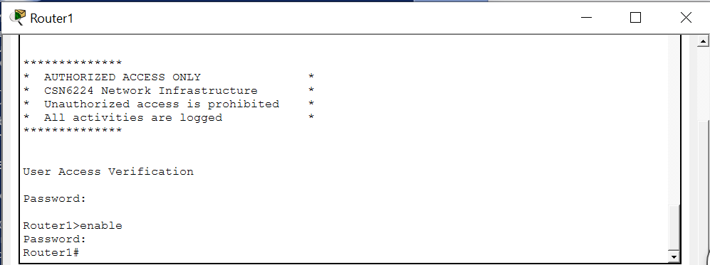
SECURITY
ROUTER1:
Interfaces: Gi0/2, Gi0/1, Vlan1
OSPF routing
Passwords: Enable-secret: Secure@R1#2026, Console: Console@R1, VTY: VTY@R1secure, SSH: admin/Admin@2026!
ACLs: 101, 102
SSH enabled
Banner message
SWITCHES (Switch1, Switch3, Switch4, Switch5, Switch11): x = switch number
Enable-secret: Secure@SWx#2026
Console: Console@SWx
VTY: VTY@SWxsecure
Trunk ports configured
Password encryption enabled

Slide 9
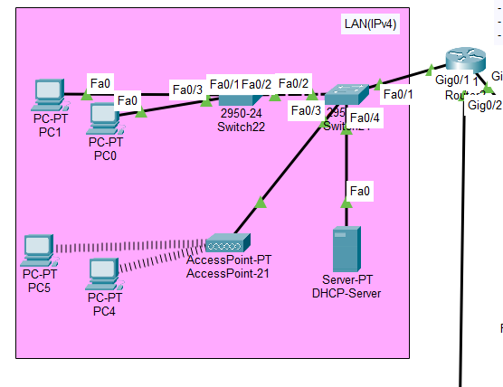
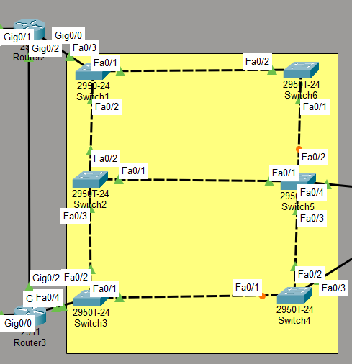
Network 1 and Routing
Member 2 :
LAMA M. R. SIAM
242UC243B4

Slide 10
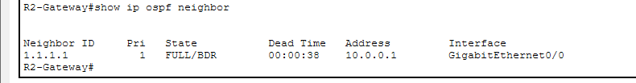
🔄 NETWORK AND ROUTING
Network uses OSPF (Open Shortest Path First)
Reasons for using OSPF:
Automatic route updates
Fast failover
Scalable for large networks
Industry standard
Routers from FULL neighbor relationship
OSPF CONFIGURATION DETAILS:
✓ All routers in Area 0
✓ Router IDs: 1.1.1.1, 2.2.2.2, 3.3.3.3
✓ Dynamic route learning
✓ Convergence time: ~5 seconds
✓ Automatic failover enabled

Slide 11
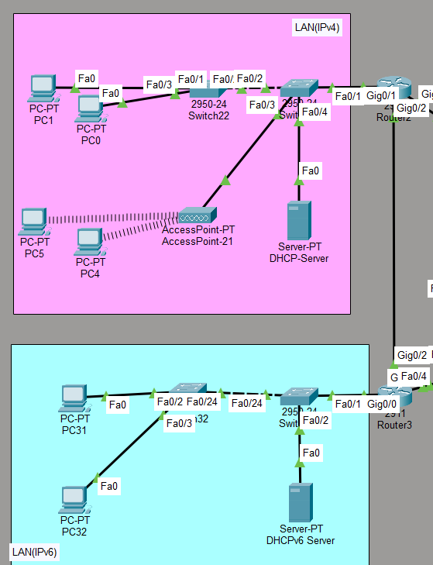

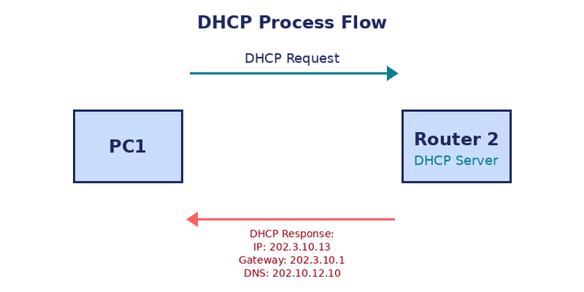
💻 DHCP CONFIGURATION
Configure on Router 2
Automatically assigns IPv4 addresses
DHCP pool:
IP range: 202.3.10.10 to .100
Gateway: 202.3.10.1 (Router 2)
DNS server: 202.10.12.10 (DNS)
WHY DHCP?
✓ No manual configuration needed
✓ Eliminates human errors
✓ Saves time in large networks
✓ Automatic IP management
CURRENT STATUS:
📊 Active clients: 4
⏱️ Lease time: 24 hours
✅ All clients connected successfully

Slide 12
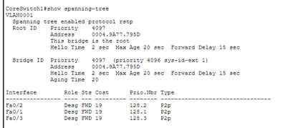
🔒 SPANNING TREE PROTOCOL (STP)
Purpose:
Prevents network loops and ensures high availability
STP configuration ⚙️:
Core-Switch-1 → Root Bridge (Priority 4096)
Core-Switch-2 → Backup Root (Priority 8192)
Mode: Rapid-PVST+ (fast convergence)
How it works:
• Red links = Blocked (backup paths)
• Green links = Forwarding (active paths)
• If primary path fails → Backup activates automatically

Slide 13
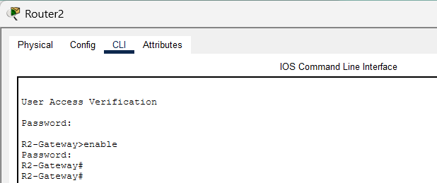
SECURITY MEMBER 2 - NETWORK SECURITY CONFIGURATION (IPV4 USER NETWORK - PINK AREA)
ROUTER2 (R2-Gateway):
- Interfaces: Gi0/0, Gi0/1
- OSPF routing (Router ID: 2.2.2.2)
- DHCP server (Pool: IPv4_Users_Pool)
- Passwords:
- Enable-secret: Enable@123
- Console: Console@123
- VTY: Admin@123
- SSH: admin/Admin@123
- SSH enabled (version 2, RSA 1024-bit)
- Domain: company.com
SWITCHES (Switch21, Switch22):
- Enable-secret: Secure@SW21#2026 / Secure@SW22#2026
- Console: Console@SW21 / Console@SW22
- VTY: VTY@SW21secure / VTY@SW22secure
- Password encryption: Enabled
- Trunk ports: Configured
- Access ports: VLAN 10 (IPv4_Users)
ACCESS POINT (AccessPoint-IPv4):
- SSID: Company-IPv4
- Security: WPA2-PSK
- Passphrase: Company@123
- Encryption: AES
DHCP SERVER:
- Static IP: 202.3.10.5
- Pool: 202.3.10.10 - 202.3.10.100
- Gateway: 202.3.10.1
- DNS: 202.10.12.10

Slide 14
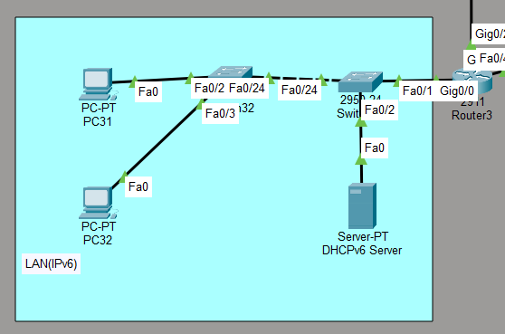
Network 2 and Testing
IPV6 USER NETWORK
SITI ZULAIKHA BINTI ABDUL RAZIF
242UC243TL
IPv6-only user network
IPv6 subnet:
2001:db8:0909:2005::/64
Router 3 Gateway:
2001:db8:0909:2005::1
5 IPv6 clients: from ::10 to ::14
Using SLAAC
Stateless Address Autoconfiguration

Slide 15
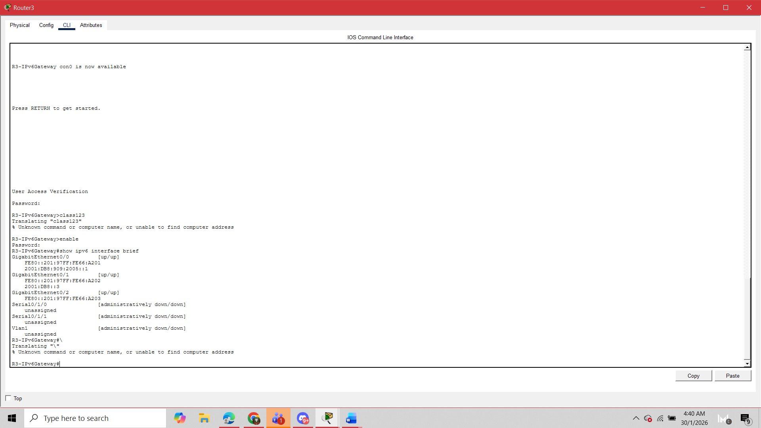
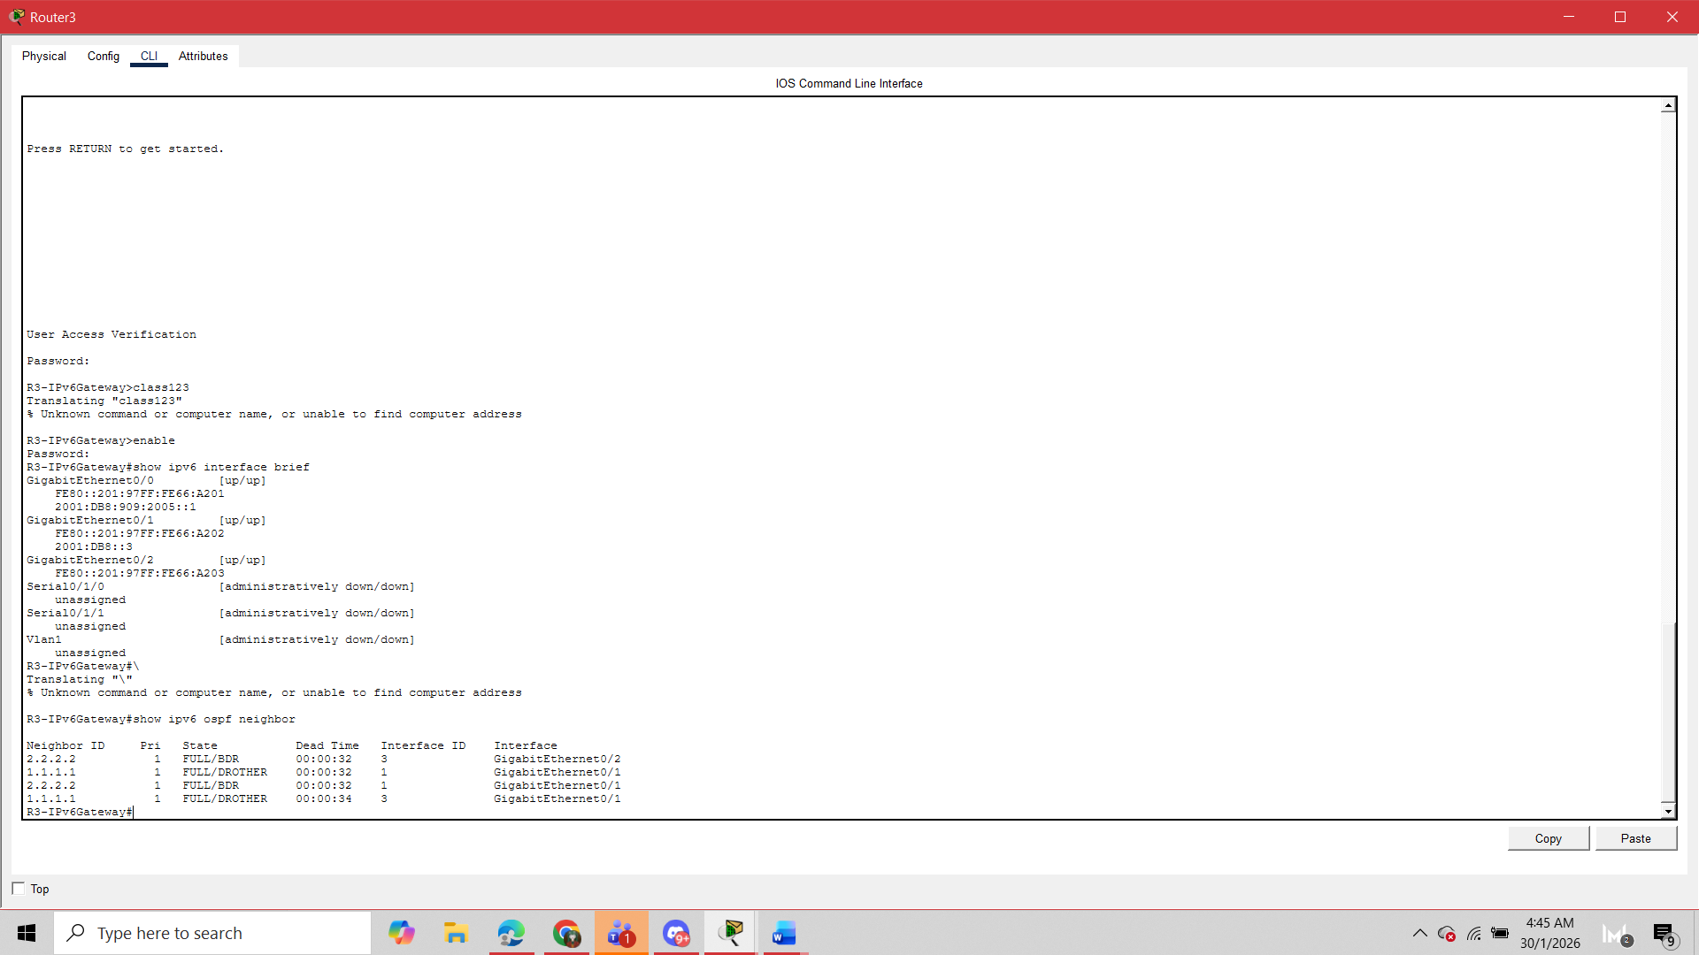
ROUTER3 INTERFACE CONFIGURATION
Gi0/0 – IPv6 Gateway 2001:db8:0909:2005::1/64
Gi0/1 – Core (Dual-Stack) IPv6 & IPv4
Gi0/2 – Link to Router2 IPv6 Link-Local
OSPFV3 & ROUTING
• OSPFv3 enabled
• Router ID: 3.3.3.3
• Neighbors: R1 & R2
• Static route as backup

Slide 16
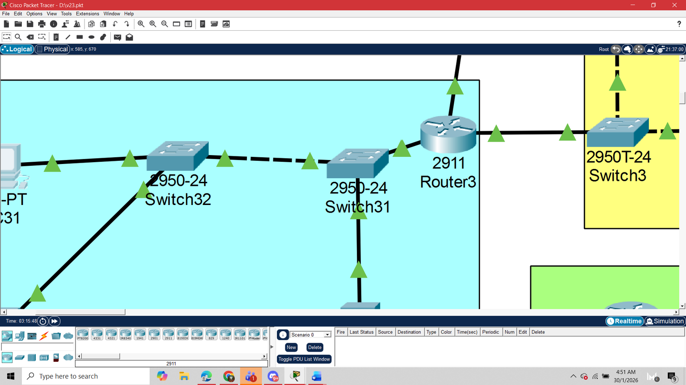
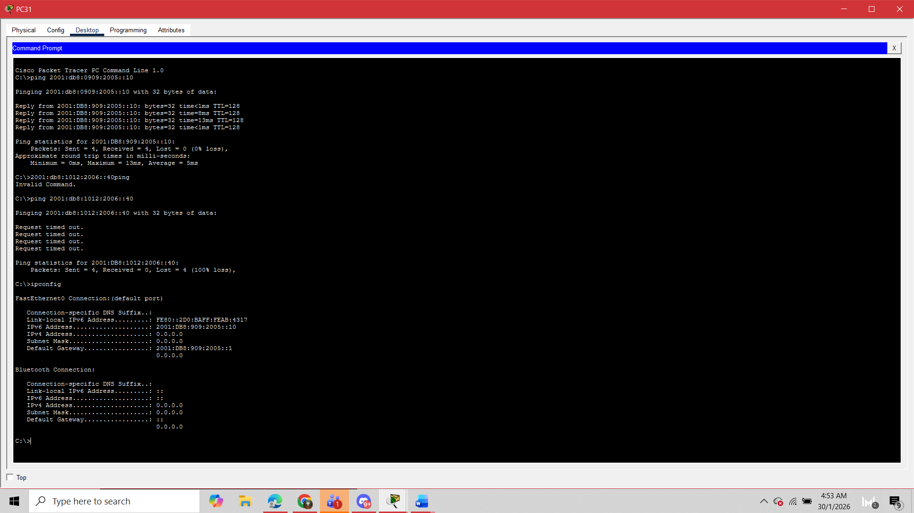
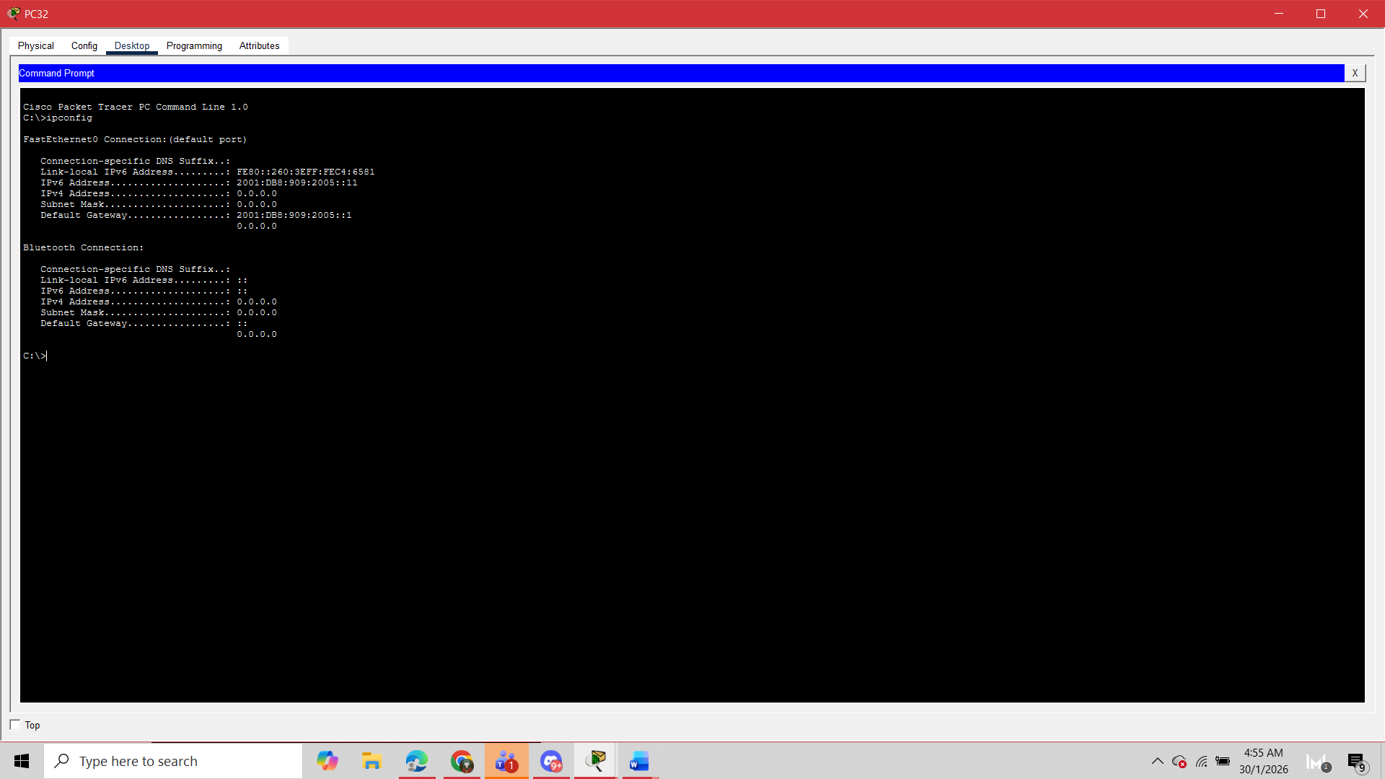

SWITCH TOPOLOGY
• Switch31 and Switch32
• Inter-switch link: Fa0/24
• High availability design
DHCPV6 & CONNECTIVITY
PC31
DHCPV6
PC32
• DHCPv6 auto-addressing
• PC31 & PC32 configured
• IPv6 tests successful

Slide 17
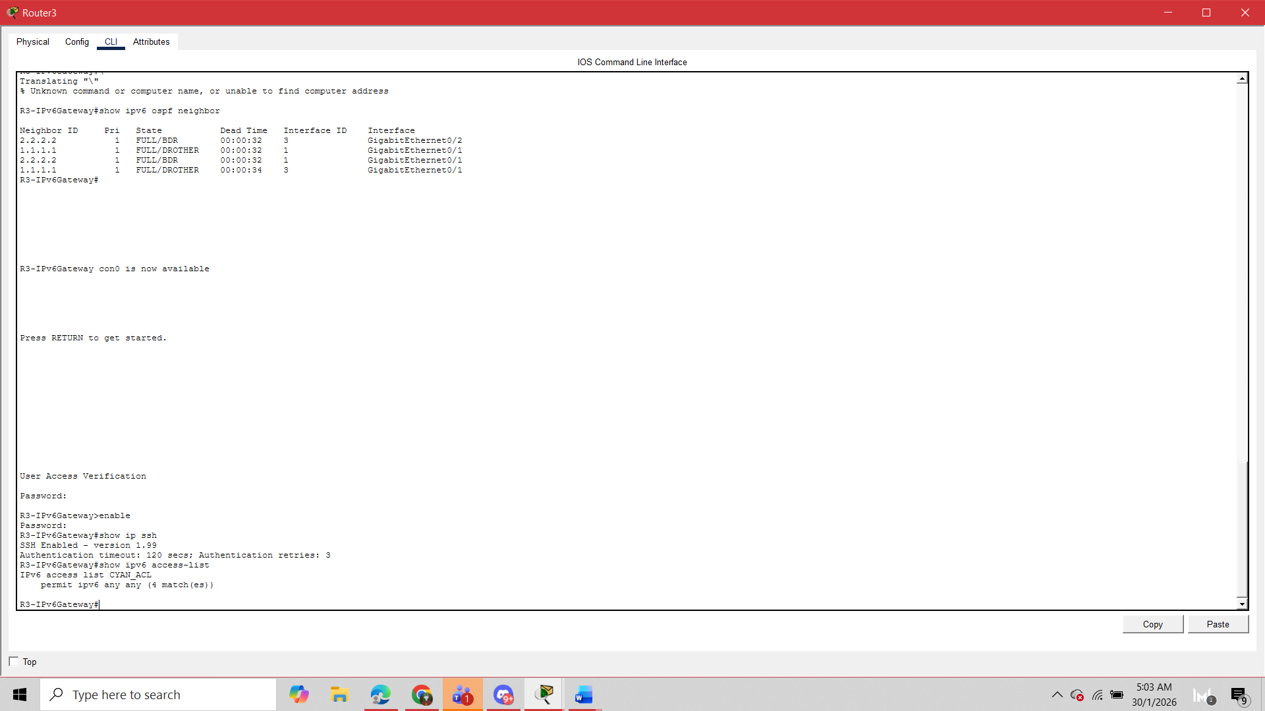
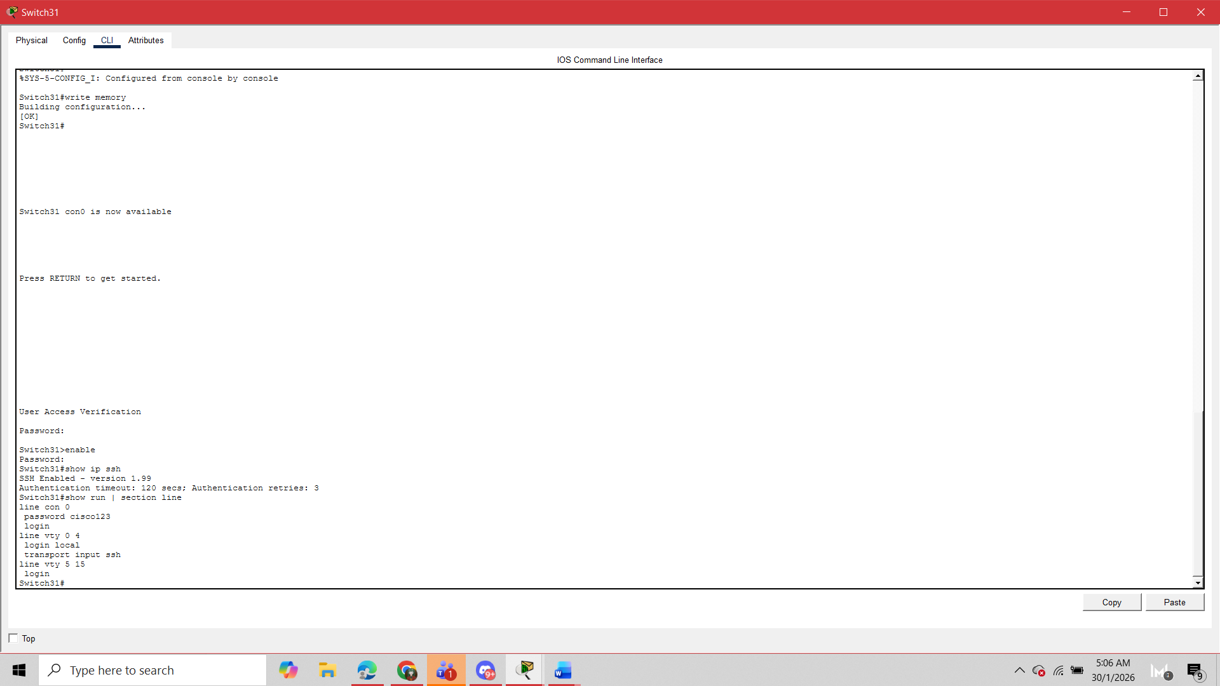
ROUTER3 SECURITY ENHANCEMENTS
Router3 Security:
• Enable-secret: class123
• Console password: cisco123
• SSH user: admin / admin123
• IPv6 Access Control Lists
SWITCH31 & SWITCH32 SECURITY
Switch31 & Switch32 Security:
• Enable-secret: class123
• Console password: cisco123
• SSH user: admin / admin123
• Telnet disabled

Slide 18
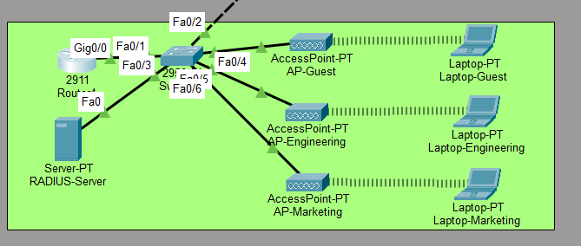


Member 4:
Moo Yu Jie 1191100199
WIRELESS NETWORK
3 Individual AP with individual wifi passcode
Marketing: Marketing@123
Engineering: Engineering@123
Guest: Guest@123
Radius system that using WPA-PSK passcode
with AAA system (need to login before connect)
DHCP for wireless network
Address pool: 202.02.06.0/24
SSH for Router4:
Username: admin
Password: Enable@123

Slide 19
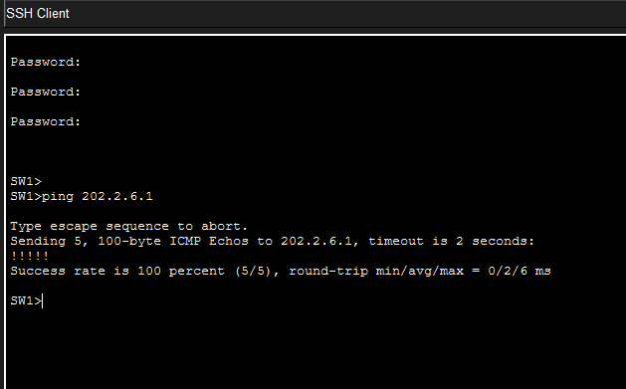
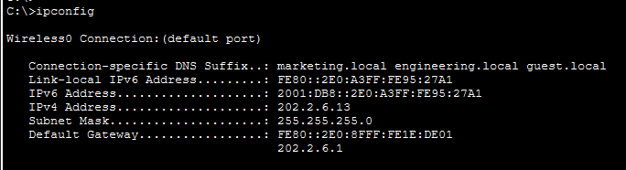
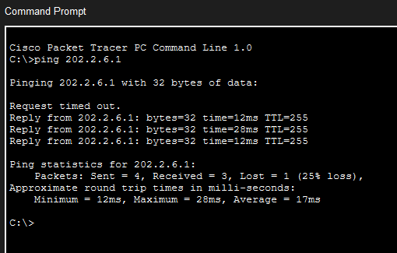
WIRELESS NETWORK
All the laptop are able to ping the server (202.2.6.1)
Configuration:
ping the other laptop or the server ip

